Slide 1
Framework and Data Model for OTN Network Slicing
draft-ietf-ccamp-yang-otn-slicing-01
Co-authors:
Aihua Guo (Futurewei)
Sergio Belotti (Nokia)
Reza Rokui (Ciena)
Luis M. Contreras (Telefonica)
Yunbin Xu (CAICT)
Yang Zhao (China Mobile)
Xufeng Liu (IBM Corporation)
Contributors:
Haomian Zheng (Huawei)
Italo Busi (Huawei)
Victor Lopez(Nokia)
Dieter Beller (Nokia)
Oscar Gonzales (Telefonica)
Henry Yu (Huawei)
Jiang Sun (China Mobile)

Slide 2
Updates Since IETF 112
Admin
WG adopted w/ interim and mailing list discussion on way moving forward
GitHub repository was transferred to CCAMP WG
https://github.com/ietf-ccamp-wg/ietf-ccamp-yang-otn-slicing
Weekly CCAMP call
https://mailarchive.ietf.org/arch/msg/ccamp/Dr3HWPlmP9LyA6NmabWJvx7hWIc/
Draft Updates
Text updates to address comments and consensus from the interim and mailing list
Alignment with relevant drafts
TEAS NS framework
TEAS NS YANG NBI
TEAS Applicability of ACTN to slicing
draft-contreras-teas-slice-controller-models

Slide 3
Conclusions to Move Forward With OTN Slicing
IETF network slicing is wider in scope beyond 5G or IP only
Technology-specific slicing (e.g. OTN) is in scope for IETF network slicing
Use cases for OTN justifies the need for slicing in OTN
“Slice” and “OTN Slicing” are proper terms for OTN in the context of IETF network slicing
An OTN slice is an IETF network slice when the IETF network is OTN
OTN-SC is a IETF NS realizer for OTN
L1VPN, TE topology, TE tunnel etc. are possible realization of an OTN slice
OTN-SC NBI is an intent-based interface describing what customer needs
Top-down configuration
OTN-SC NBI (technology specific) should augment IETF NSC NBI(technology agnostic)

Slide 4
-01 Text Update
Added descriptions for three options of configuring and realizing an OTN slice
Added text to clarify the relationship between OTN slice intent (NBI) and realization
Added text to indicate that OTN-SC NBI is technology specific and augments the IETF NSC NBI
Fixed non-technical setting of the document by addressing Tom’s comments
Other cosmetic updates as per mailing list comments

Slide 5
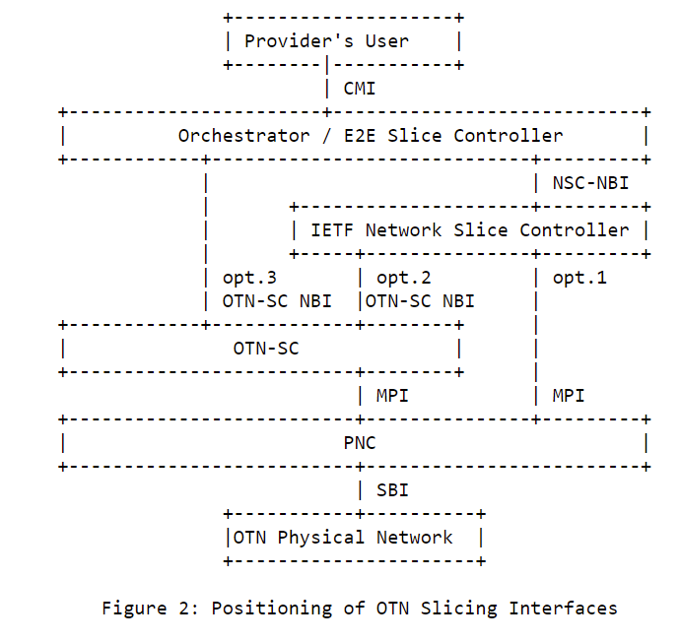
Updated Diagram
Option 1: IETF-NSC --> PNC.
Option 2: IETF-NSC --> OTN-SC --> PNC.
Option 3: Orchestrator --> OTN-SC --> PNC

Slide 6
-01 YANG Model Update
Minor adjustments in formatting to conform with IETF YANG guidelines

Slide 7
Harmonizing w/ draft-ietf-teas-ietf-network-slice-nbi-yang
Agreed for the OTN-SC NBI model to augment the network-slice-nbi model
Currently analyzing the model structures of network-slice-nbi
Whether it contains required parameters
Whether these parameters are technology-agnostic
Whether the base model supports resource based slicing by configuring slices with topologies

Slide 8
Harmonizing w/ draft-ietf-teas-applicability-actn-slicing
Agreed for draft-ietf-teas-applicability-actn-slicing to update the figure that describes the mapping of IETF NSC – ACTN MDSC
An MDSC consists of a Service Orchestrator and a Network Orchestrator
IETF NSC-NBI / OTN-SC NBI == interface between MDSC SO and NO, e.g. XMI

Slide 9
Next Steps
Continue to address comments from the WG
Align and augment ietf-network-slicing-yang
Identify and separate technology-specific vs. technology-agnostic constructs
Add support for resource-based slicing in the augmented model
Define OTN technology-specific SLOs

Slide 10
Thank You!

